Slide 1

Did Twitter data predict Trump’s election?
Fundamentals of data science – Group 15
Daphnee chabal, Max Crous, Savvina Daniil, Albert Folch, Elena Gkerpini
University of Amsterdam, Amsterdam, The Netherlands

Slide 2

UNITED STATES PRESIDENTIAl

Slide 3
UNITED STATES PRESIDENTIAl
Question 1: Are Twitter users who wrote about the election representative of the general population, especially among US voters?
Question 2: Do tweet sentiment, topic, and engagement predict the result of the election and if so, which metrics revealed a candidate’s advantage over the other in the public opinion?

Slide 4
methods
Data Set
Preprocessing
Tweet Classification
657,307 tweets
@HillaryClinton, @realDonaldTrump
#maga, #trumppence16, #hillaryclinton, #hillary, #crookedhillary, #donaldtrump, #dumptrump, #nevertrump, #imwithher, #neverhillary, #trump
Text body and Hashtags Extraction
NLTK library and regular expressions
Lemmatization
TEXT BODY
HASHTAGS
TOPIC ANALYSIS: MEXICO

Slide 5
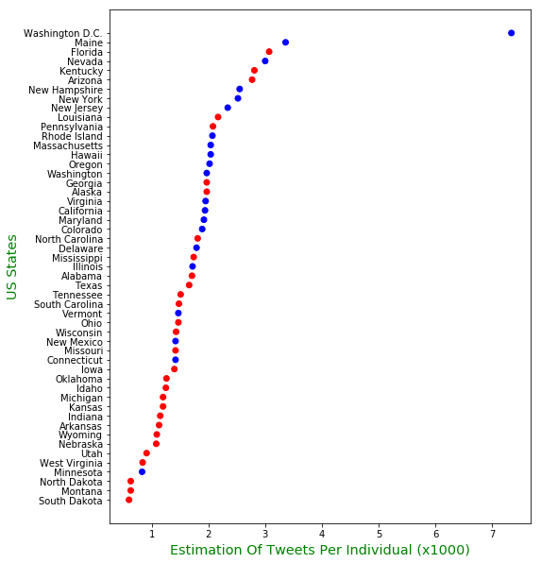
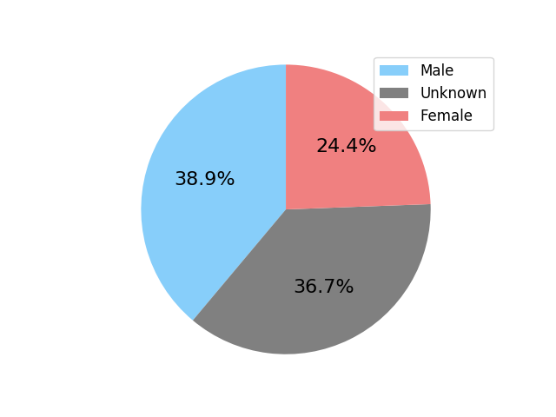
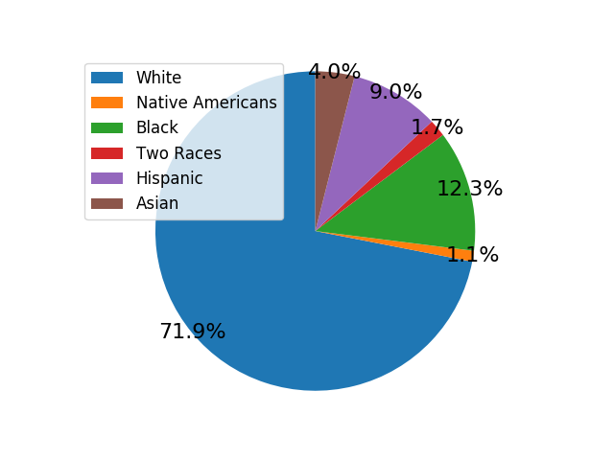
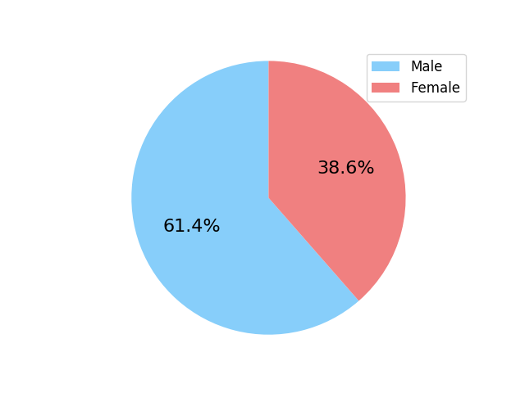
Results: twitter users

Slide 6
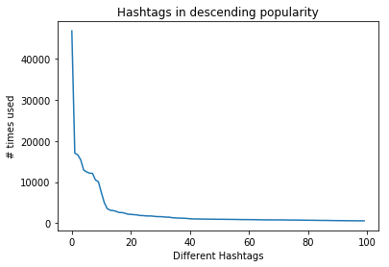
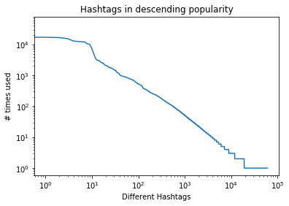
Results: hashtag distribution

Slide 7
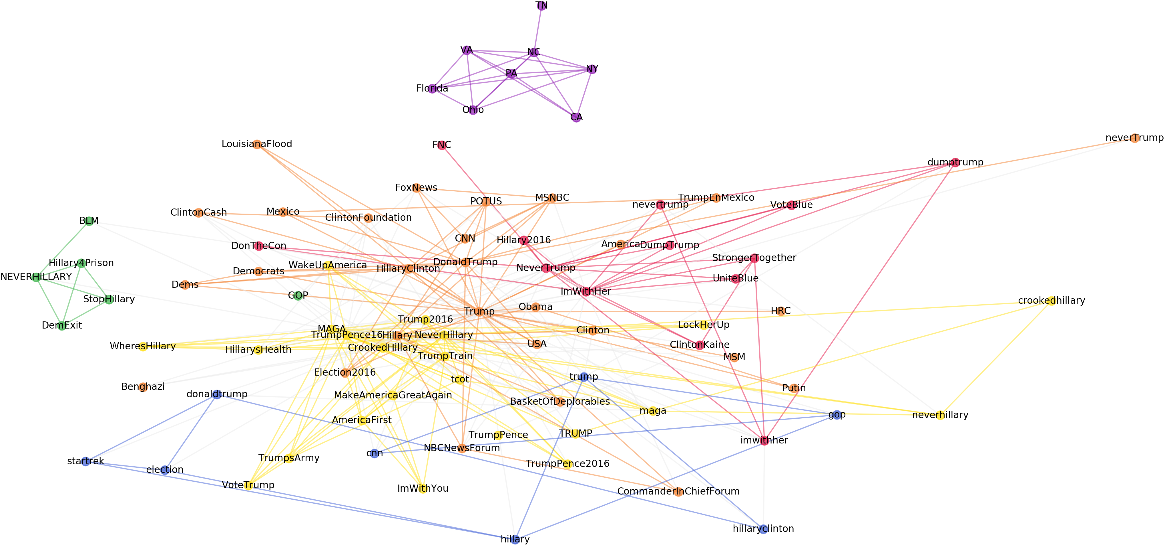
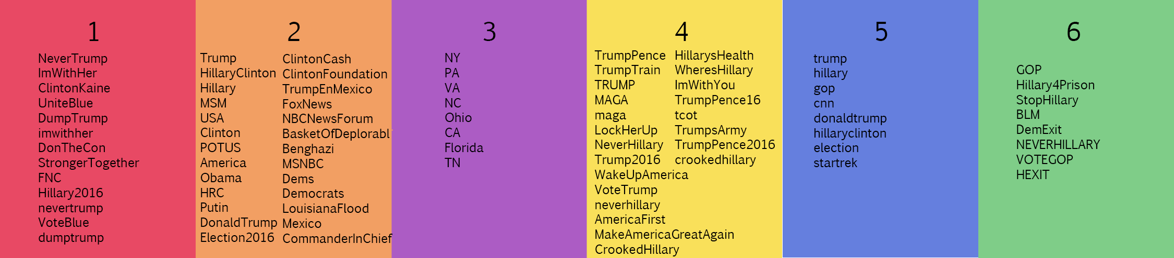
Results: sentiment analysis on text body

Slide 8
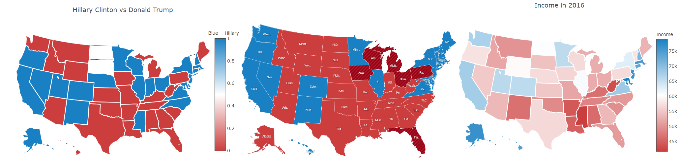
Estimation based on Tweets VS Actual Election Results VS Actual Average Income (2016)
Results: TOPIC analysis on text body

Slide 9
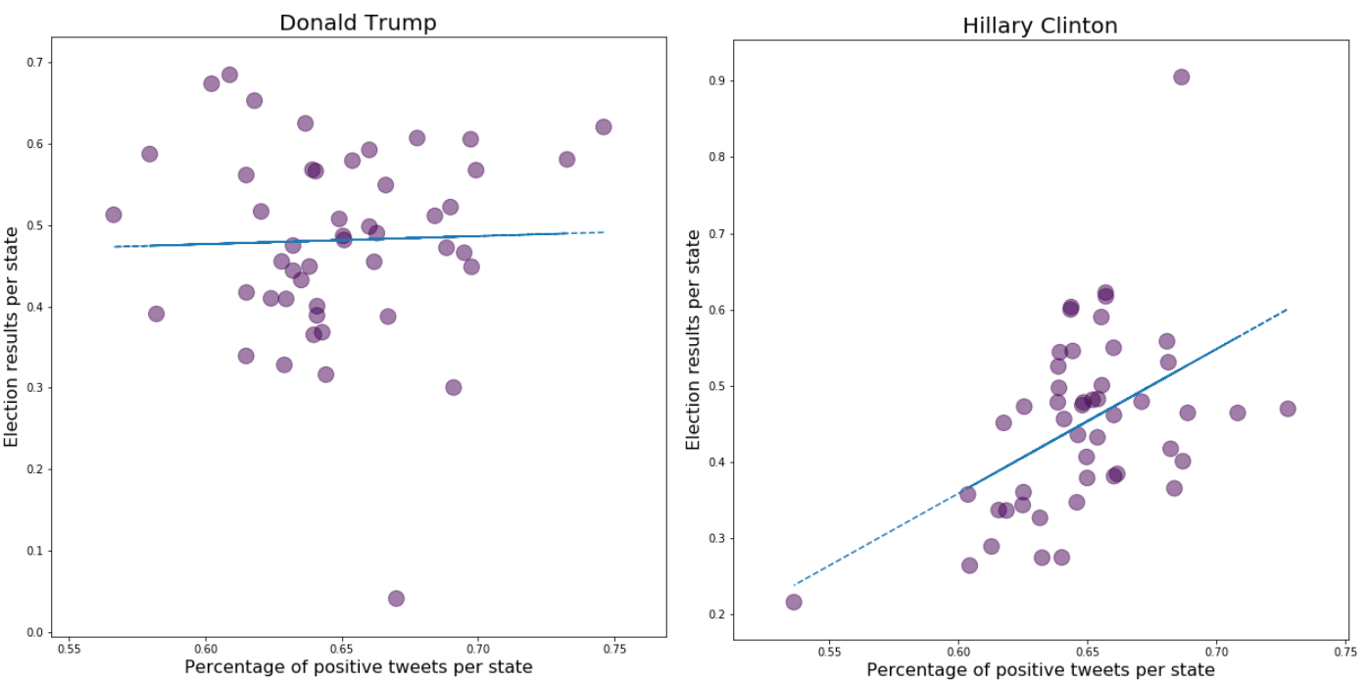
Results: TOPIC analysis on text body

Slide 10
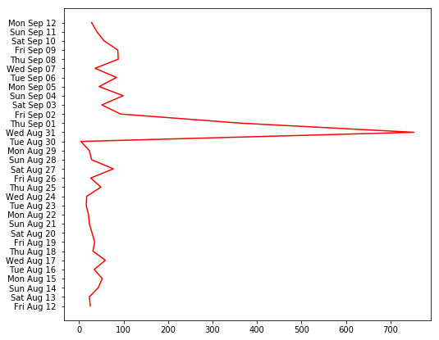
Results: mexico

Slide 11
conclusion
fINDINGS
lIMITATIONS
Not Representative Sample ++
Predictions ++ Per State ++
Mexico ++
++

Slide 12
REFERENCES
Blablablablablabla ++

